Slide 1
PIZZAPAL:
INSIGHTS IN PIZZA ORDERS AND REVENUE
SYEDA UMME KULSUM

Slide 2
KEY CHARACTERISTICS
IMPLEMENTED JOINSOVER MULTIPLE TABLES
DESIGNED SQL VIEWS
1
2
AGGREGATED FUNCTIONS
ADVANCE SUBQUERIES
3
4

Slide 3
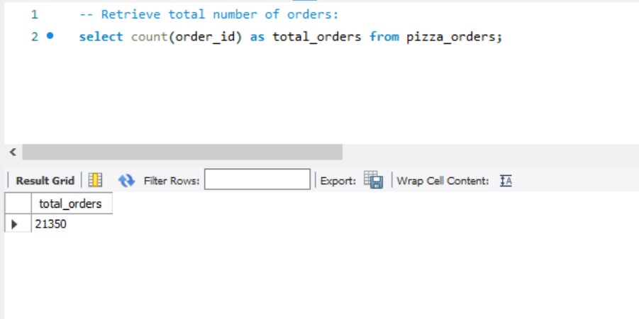

Slide 4
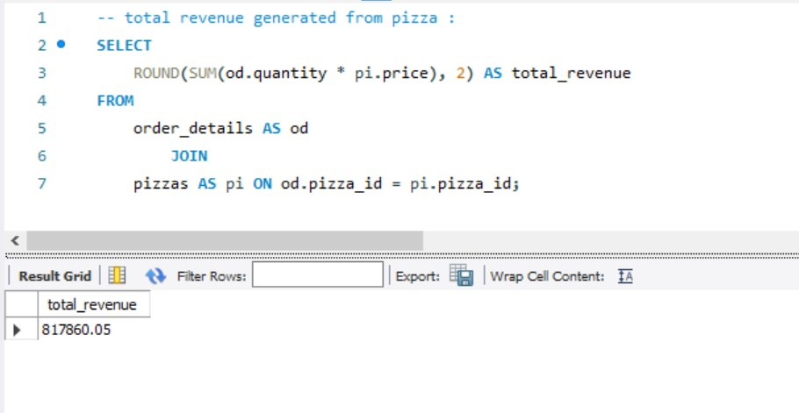

Slide 5
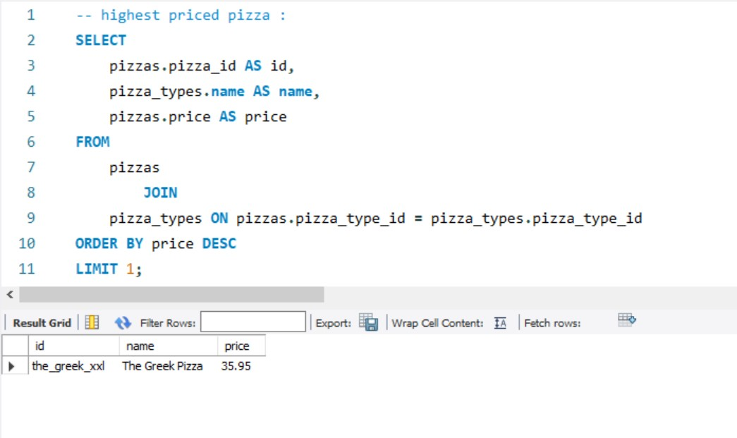

Slide 6
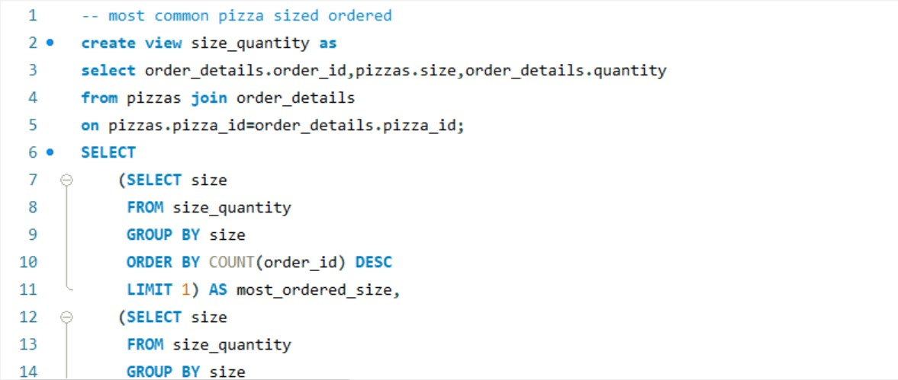

Slide 7
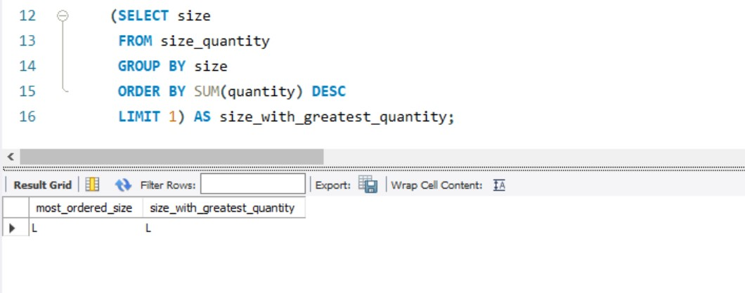

Slide 8
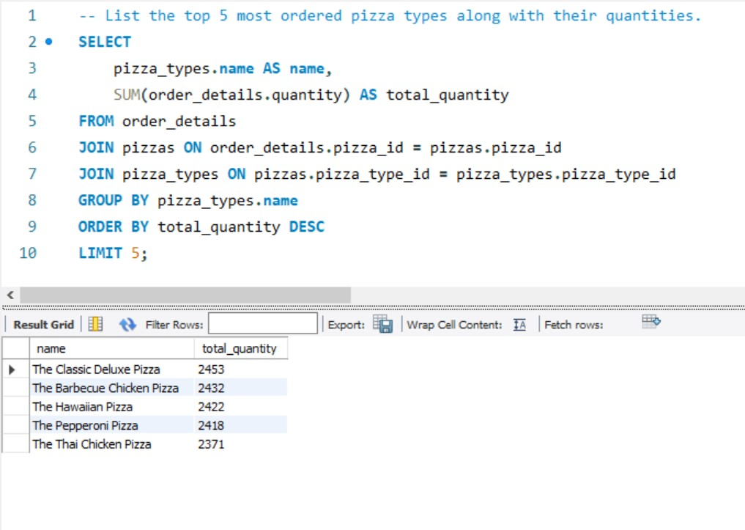

Slide 9
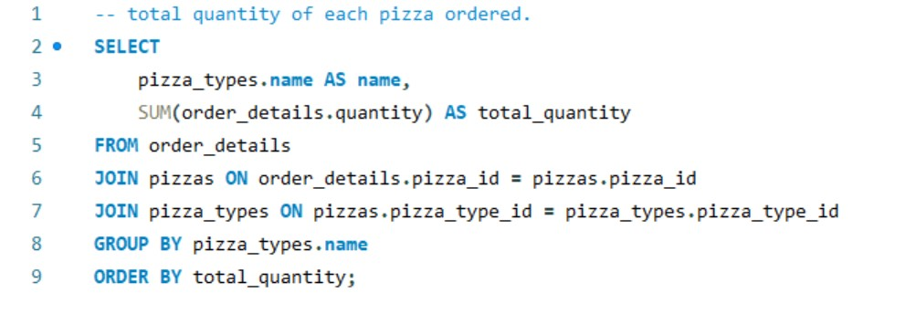

Slide 10
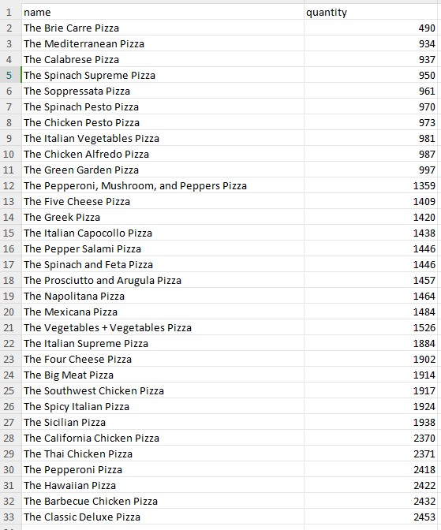
Data Exported into a separate datafile(.csv)

Slide 11
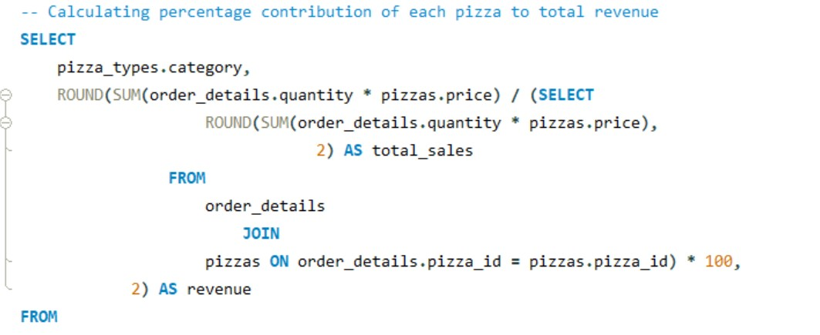

Slide 12
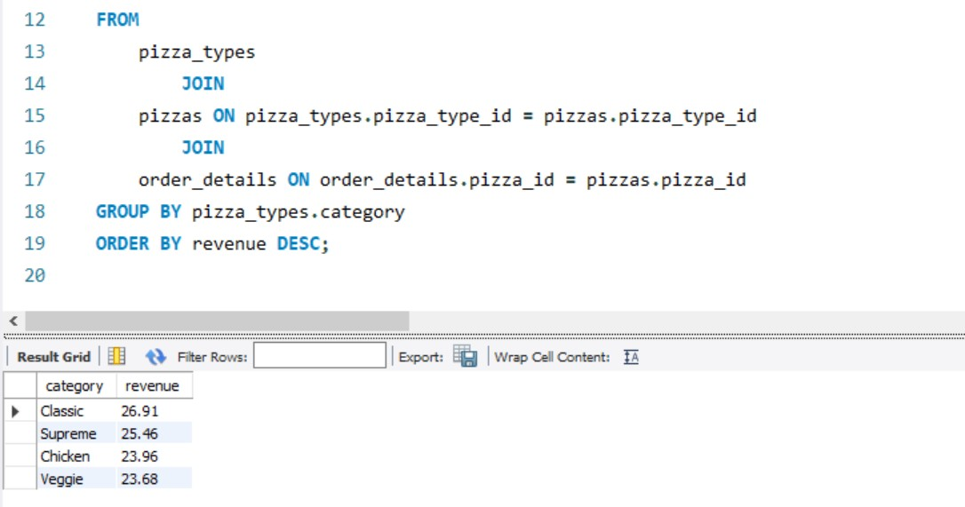

Slide 13
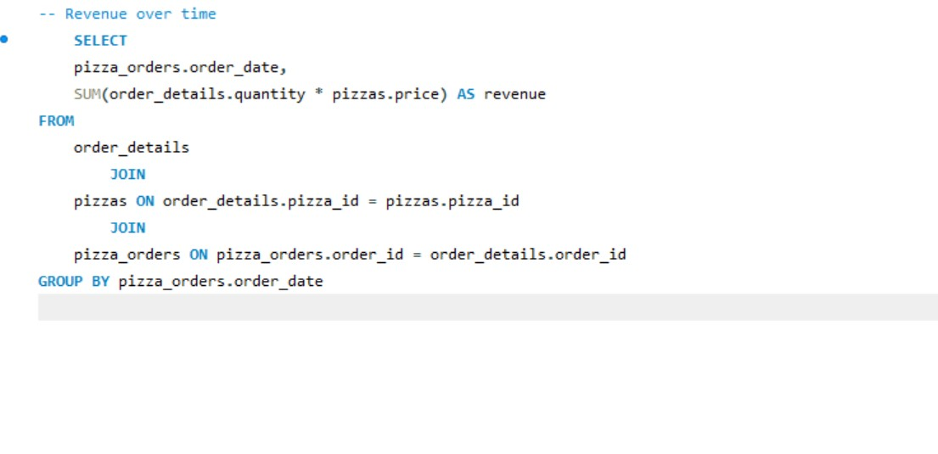

Slide 14
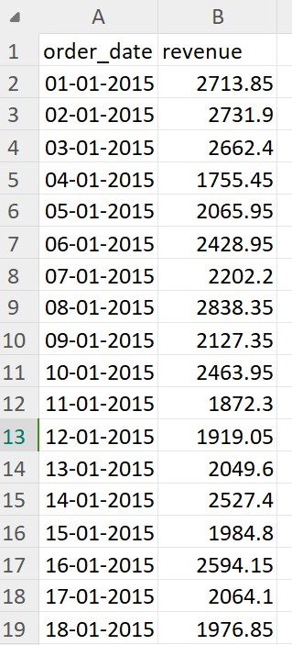
Data Exported into a separate datafile(.csv)

Slide 15
INSIGHTS OBSERVED OR DERIVED
REVENUE
ORDER WITH DAY
PIZZA TYPE
PIZZA SIZE
$ 827860 was the observed revenue of the given dataset, however the following measures are noted to have direct impact on it
There are no cumulative analysis on dates, however further analysis contributing days of the week can be implemented
The greek pizza is tthe most popular and most selling
The most selling pizza size on all pizza types is Large

